Slide 1
Solidity Functions
Loke KS

Slide 2
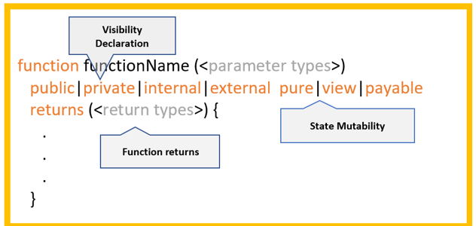
Functions
Functions are defined within the contract. After the function name and the function, we can declare its visibility, state mutability and the return types of the function

Slide 3
Function Visibility
In general, a function can be called in three ways: by the contract it is defined in, by a derived contract or another third-party contract.
These are affected by its visibility settings.
There are 4 visibility settings:
private
public
External
internal.
Those visibility declarations can be applied both to functions and variables except for the external keyword which is only for functions.

Slide 4
Function Visibility
A private function is one that can only be called by the contract it is defined in. Private functions are only visible for the contract it is defined in, and not even in derived contracts.
An internal function can be called by the main contract itself, plus any derived contracts.
An external function can only be called from a third party. It cannot be called from the main contract itself or any contracts derived from it directly.
External functions are sometimes more efficient when they receive large arrays of data because the data is not copied from calldata to memory.*
Finally, a public function can be called from all potential parties. Unless otherwise specified, all functions are made public by default.

Slide 5
Function Visibility
A function call from one contract to another does not create its own transaction, it is a message call as part of the overall transaction.
Internal function calls are made by simple jumps inside the EVM. This has the effect that the current memory is not cleared, i.e. passing memory references to internally called functions is very efficient
An external function call is made via a message call and not directly via jumps
The expressions this.g(8); and c.g(2); (where c is a contract instance) are external function calls.
Functions of other contracts have to be called externally

Slide 6
Mutability
A part of defining a function, you also declare its state mutability and return types of the function. The state mutability keywords are view, pure and payable.
Functions that are marked payable can receive ether
A function marked as view indicates that the function does not modify the state
The following statements are considered modifying the state:
Writing to Ethereum state variables, i.e. accessing address balance
Emitting events.
Creating other contracts.
Using selfdestruct.
Sending Ether via calls.
Calling any function not marked view or pure.
Using low-level calls and certain inline opcodes

Slide 7
Mutability
A pure function is one that not only does not modify the state, but also do not read from state.
It is not possible to prevent functions from reading the state at the level of the EVM, it is only possible to prevent them from writing to the state.
The following are considered reading from the state:
Reading from state variables.
Accessing address(this).balance or <address>.balance.
Accessing any of the members of block, tx, msg (with the exception of msg.sig and msg.data).
Calling any function not marked pure.
Using inline assembly that contains certain opcodes.

Slide 8
Getter Functions
All public state variables are automatically generated getter functions. The getter functions have an external visibility.
If the symbol is accessed internally (i.e. without this.), it evaluates to a state variable.
If it is accessed externally (i.e. with this.), it evaluates to a function.
However, for an array type, the automated getter function only generates a function to retrieve a single element.

Slide 9
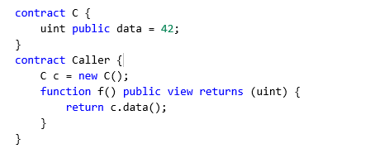
Getter Functions

Slide 10
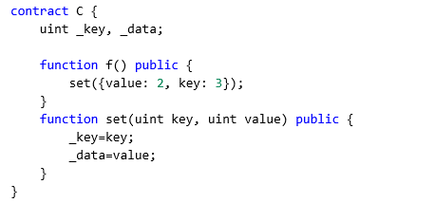
Function Arguments
Function call arguments can be given by name, in any order, if they are enclosed in { }.

Slide 11
Data Location
Explicit data location for all variables of struct, array or mapping types is now mandatory. This is also applied to function parameters and return variables.
Reference types comprise structs, arrays and mappings. If you use a reference type, you always have to explicitly provide the data area where the type is stored:
memory (whose lifetime is limited to a function call)
storage (the location where the state variables are stored)
calldata (special data location that contains the function arguments, only available for external function call parameters).

Slide 12
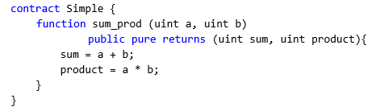
Return Variables
Function return variables are declared with the same syntax as function arguments after the returns keyword.
The names of return variables can be omitted.
Return variables can be used as any other local variable and they are initialized with their default value and have that value until they are (re-)assigned.

Slide 13
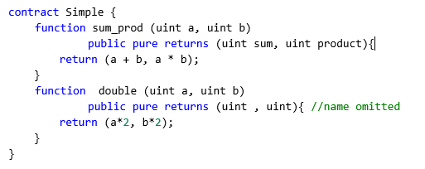
Return Variables
You can either explicitly assign to return variables and then leave the function using return; or you can provide return values (either a single or multiple ones) directly with the return statement:

Slide 14
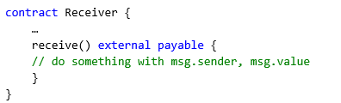
Special Functions - receive()
A contract can have a special function called ‘receive’ to receive Ether. This function is declared without the ‘function’ keyword, and you can have at most only 1 per contract
This is the function that is executed on plain Ether transfers (e.g. via .send() or .transfer()). If this function is not defined, the payable fallback function, if it exists, will be called instead. If neither exist, then the contract cannot receive Ether and an exception will be thrown.

Slide 15
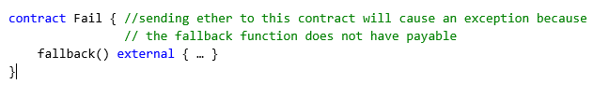
Special Functions - Fallback function
A contract can have at most one fallback function, declared using fallback () external [payable]. Note that it is declared without the function keyword
It is executed on a call to the contract if none of the other functions match the given function signature, or if no data was supplied at all and there is no receive Ether function. The fallback function always receives data, but in order to also receive Ether it must be marked payable.

Slide 16
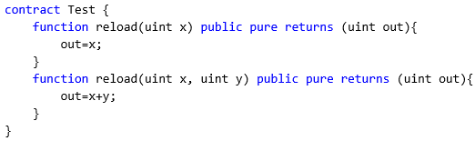
Function Overloading
A contract may have functions of the same name, but their parameter types have to be different. This is called function overloading. Function overloading also applies to inherited functions.

Slide 17
Special Variables and Functions
In Solidity there are special variables and functions which always exist globally and are mainly used to provide information about the blockchain.
They can also be used to assist with error handling, employ mathematical and cryptographic functions, and present information about contract addresses and the contracts themselves.

Slide 18
msg global
The msg global variables in particular are special global variables that contain properties which allow access to the blockchain. For instance, msg.sender is always the address where the current (external) function call came from.
The msg.sender special global variable to obtain the current user’s address (e.g., 0x44d33a….) from where the function call came from.
The values of all members of msg, including msg.sender and msg.value can change for every external function call

Slide 19
msg.sender and tx.origin
msg.sender gives the direct sender of the message, so for example a contract that passed it along.
tx.origin gives the origin of the transactions, so the user address it was originally sent from.
With msg.sender the owner can be a contract.
With tx.origin the owner can never be a contract
In a simple call chain A->B->C->D, inside D msg.sender will be C, and tx.origin will be A.

Slide 20
Other special variables
block.gaslimit (uint): current block gaslimit
block.number (uint): current block number
block.timestamp (uint): current block timestamp as seconds since unix epoch
gasleft() returns (uint256): remaining gas
msg.data (bytes calldata): complete calldata
msg.sender (address payable): sender of the message (current call)
msg.sig (bytes4): first four bytes of the calldata (i.e. function identifier)
msg.value (uint): number of wei sent with the message
now (uint): current block timestamp (alias for block.timestamp)
tx.gasprice (uint): gas price of the transaction

Slide 21
Function modifiers
Solidity function modifiers are a programming construct that is not commonly found in other programming languages.
Modifiers are used to alter the behavior of a function usually used to check a condition or restrict access before the function is allowed to proceed.
Because the function modifiers are encapsulated and can be inherited, they encourage re-use.
Modifiers can be used to:
Restrict access
Validate inputs

Slide 22
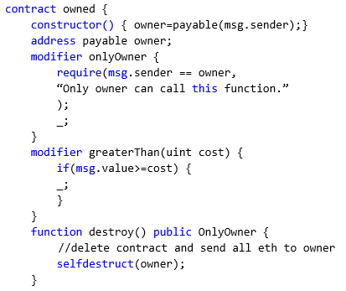
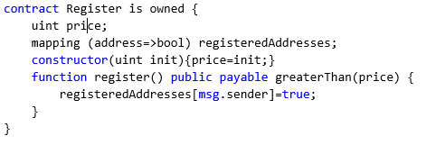
Function modifiers

Slide 23
Function modifiers
In the example we have to functions with different modifiers OnlyOwner and greaterThan.
The modifiers will proceed to run before the function.
The modifiers have a special symbol _ (underscore) to indicate where the function should be inserted for execution.
In both the example above, the modifiers check a condition before the actual function is run.
If the condition failed, then an exception is thrown

Slide 24
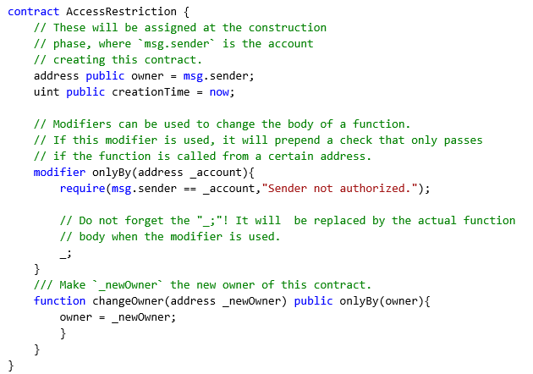
Example Usage

Slide 25
Error handling
Solidity uses state-reverting exceptions to handle errors. Such an exception undoes all changes made to the state in the current call (and all its sub-calls) and flags an error to the caller.
When exceptions happen in a sub-call, they “bubble up” (i.e., exceptions are rethrown) automatically unless they are caught in a try/catch statement

Slide 26
Error handling
The convenience functions assert and require can be used to check for conditions and throw an exception if the condition is not met.
The assert function should only be used to test for internal errors, and to check invariants.
The require function should be used to ensure valid conditions that cannot be detected until execution time.
This includes conditions on inputs or return values from calls to external contracts.
The full list for both function can be found in the solidity documentation

Slide 27
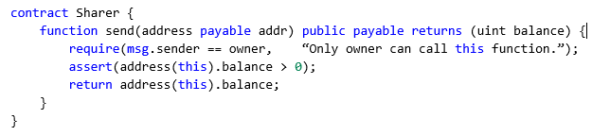
Require and Assert

Slide 28
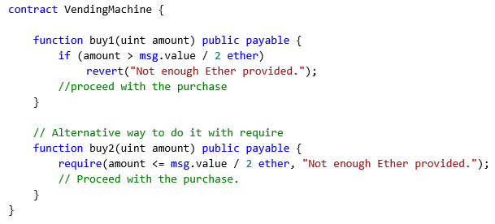
Revert
The revert function is another way to trigger exceptions from within other code blocks to flag an error and revert the current call.

Slide 29
Try-catch
A failure in an external call can be caught using a try/catch statement.
The try keyword has to be followed by an expression representing an external function call or a contract creation such as in new ContractName().
It only catches errors happening inside the external call only, errors inside are not caught including those in an internal function.
In the case there are no errors, the contract execution begins inside the first success block, and continues after all the catch blocks.

Slide 30
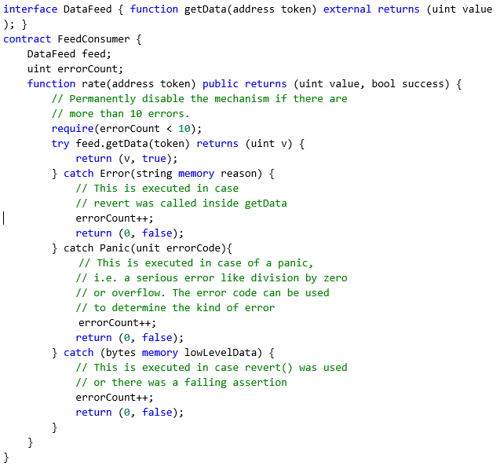
Example

Slide 31
Data Types
Solidity value types include booleans, integers, addresses, contract types, fixed-size byte arrays, rational and integer literals, and enums. There is no native support for floating-point numbers in the core language.
Reference types such as arrays, structs and mappings can be stored in these options: memory, storage, and calldata.
struct is a user defined type for group several variables together.
enum types are used to create a user defined type that consist of constant values

Slide 32
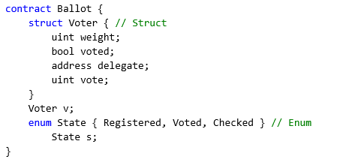
Data Types

Slide 33
Booleans
Booleans are types that have only constants true or false.
Operators:
! (logical negation)
&& (logical conjunction, “and”)
|| (logical disjunction, “or”)
== (equality)
!= (inequality)

Slide 34
Integers
Integers int/uint can be defined as signed or unsigned with the size from 8 bits up to 256 bits. uint and int are aliases for uint256 and int256, respectively
Operators on integers are:
Comparisons: <=, <, ==, !=, >=, > (evaluate to bool)
Bit operators: &, |, ^ (bitwise exclusive or), ~ (bitwise negation)
Shift operators: << (left shift), >> (right shift)
Arithmetic operators: +, -, unary -, *, /, % (modulo), ** (exponentiation)

Slide 35
Integers
The modulo operation a % n yields the remainder r after the division of the operand a by the operand n, where q = int(a / n) and r = a - (n * q).
This means that modulo results in the same sign as its left operand (or zero) and a % n == -(-a % n) holds for negative a:
int256(5) % int256(2) == int256(1)
int256(5) % int256(-2) == int256(1)
int256(-5) % int256(2) == int256(-1)

Slide 36
Array and Slices
Arrays are used to store a sequential collection of elements of the same type. They are zero indexed and can either have a fixed size at compile time or have dynamic size. Array have function members:
length : returns the number of elements
push() : append a zero-initialized element at the end of the array. (for dynamic size array only)
push(x) : append x to the end of the array (for dynamic size array only)
pop: remove the element at the end. (for dynamic size array only)
Array slices allow selection of a section of the array. They are written as x[start:end], where start and end are expressions resulting in a uint256 type (or implicitly convertible to it).
The first element of the slice is x[start] and the last element is x[end - 1].

Slide 37
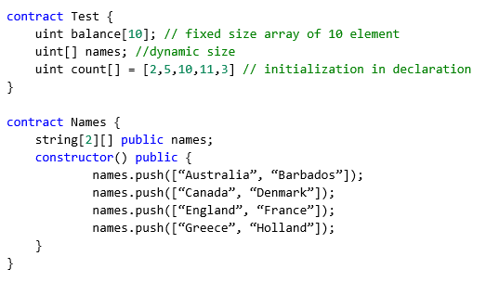
Array and Slices
The variable names can hold an unlimited number of arrays, but each of these arrays can hold a maximum of 2 values.
If we try to push an array with 3 names, there will be an error.

Slide 38

Memory Array
A memory array is an array created within a function otherwise it would be stored in storage. Because it is part of the memory, it is not persistent, so the array is erased after the function has executed. It is not possible to resize memory arrays. To create a memory array, use the new keyword.

Slide 39
Libraries
A library is like a type of default base contract of contracts that use them. Libraries are stateless and does not allow payable functions nor have a fall back function.
Calling library function is as if the code is running in the contract itself (using the special low-level instruction DELEGATECALL).
Library functions can only access state variables of the calling contract if they are explicitly supplied.
The msg properties of msg.sender, msg.value, msg.data retain the values of the original call and not the library’s.
This means that a contract can dynamically load code from a different address at runtime.
Storage, current address and balance still refer to the calling contract, only the code is taken from the called address.

Slide 40
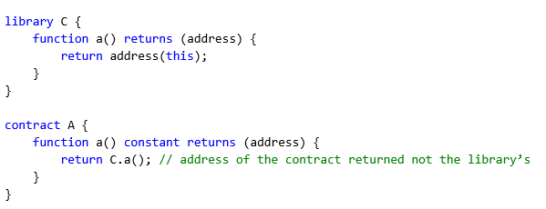
Libraries

Slide 41
Import
Solidity supports import statements to help modularise your code.
At a global level, you can use import statements of the following form:
import "filename";
This statement imports all global symbols from “filename” (and symbols imported there) into the current global scope

Slide 42
Import
The following example creates a new global symbol symbolName whose members are all the global symbols from "filename":
import * as symbolName from "filename";
import "filename" as symbolName;
which results in all global symbols being available in the format symbolName.symbol.
Remix provides an automatic remapping for GitHub and automatically retrieves the file over the network. You can import e.g.
import "github.com/ethereum/dapp-bin/library/iterable_mapping.sol" as it_mapping;

